Slide 1
Angular vs React vs Vue

Slide 2
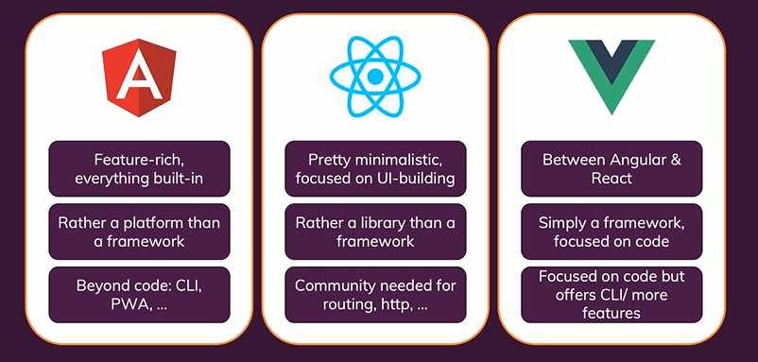
Comparison

Slide 3
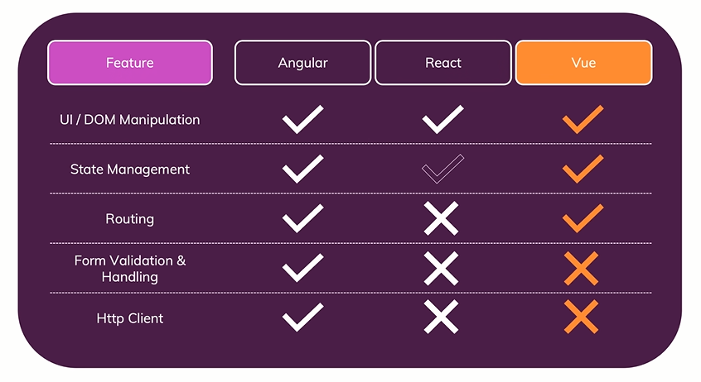
Comparison

Slide 4
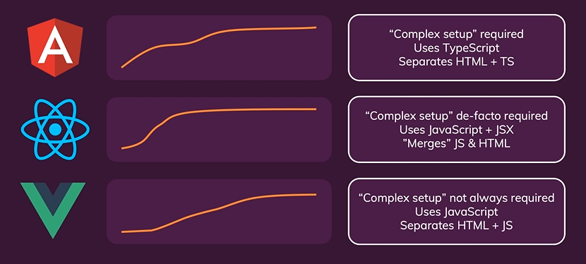
Ease of learning and getting started

Slide 5
Performance
Depends on the way you setup and configure your project.
All three are best for performance. So shouldn’t be the deciding factor.

Slide 6
Adoption and Popularity
https://trends.google.com/trends/explore?q=angular,react,vue
https://www.npmtrends.com/react-vs-angular-vs-vue
https://www.indeed.com/

